Slide 1
AVERAGE- TRICKS & TIPS

Slide 2
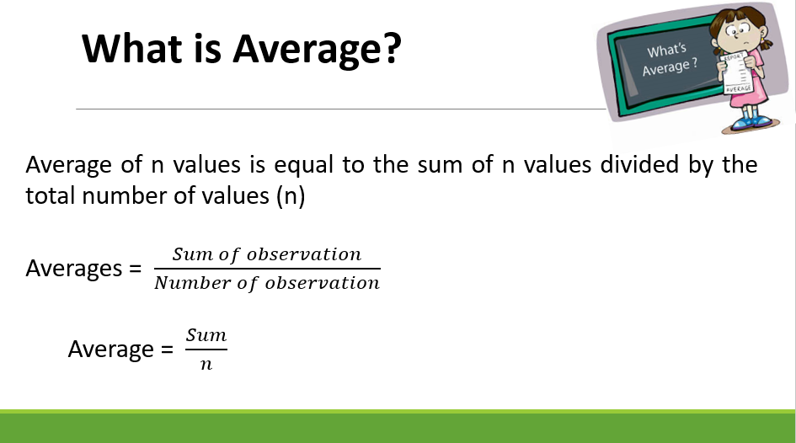

Slide 3
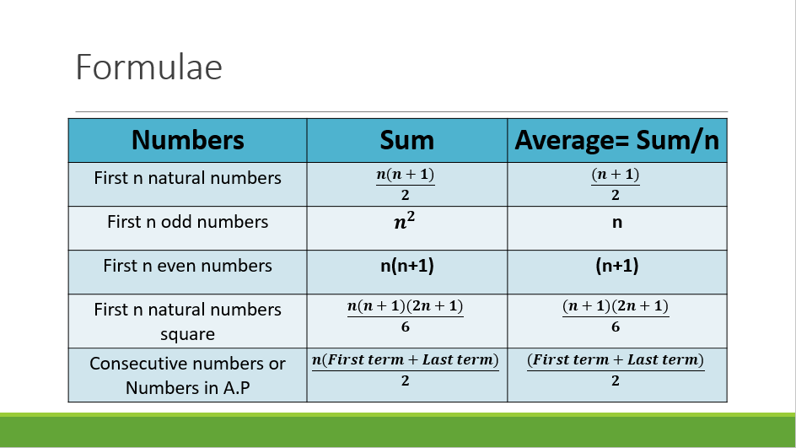

Slide 4
Some properties of Average:
If we have N number of observation as a1, a2, a3, a4 …………aN and their average is A, then
If we add or subtract the same value (suppose x) from all the observations then average will be directly added or subtracted by x.
If we multiply or divide each observation by a same value (Suppose x), then average also multiplied or divided by the same value x.

Slide 5
If terms are in A.P or consecutives
If the terms are consecutives or are in A.P then average is always the middle term of the sequence if the number of observations are odd.
If number of observations are even then average is the average of two middle numbers.

Slide 6
Question : Find the average weight of 5 boys having weights 30kg, 40kg, 50kg, 60kg, 70kg?
50 kg
40 kg
45 kg
55 kg

Slide 7
Question : Find the average of 50, 52, 54, 56, …………150
80
90
100
110

Slide 8
Question : Find the average of all even numbers up to 100.
50
51
52
55

Slide 9
Question : Find the average of 1, 3, 5, 7, 9, 11, 13, 15, 17, 19, 21
11
9
13
15

Slide 10
Question : Find the average of 13, 16, 19, 22, 25, 28
22
19
19.5
20.5

Slide 11
Question : If the average of 5 consecutive number is 21. Find the largest number.
22
23
24
25

Slide 12
Question : If the average of 5 consecutive odd number is 25, then find the smallest number.
(a) 23 (b) 21 (c) 29 (d) 19

Slide 13
Question : Find the average of first 100 natural numbers.
50
50.5
51
49

Slide 14
Question : Find the average of first 100 whole numbers.
50
50.5
49.5
49

Slide 15
Question : The average of first 10 even numbers is?
18
22
9
11

Slide 16
Question : Find the average of first 17 multiples of 5?
50
85
45
60

Slide 17
COMBINED AVERAGE
Class A
0
Class B
100
What is the combined average?
50 marks??
NO
We cannot determine the average without knowing the number of students in each class
The combined average depends on the number of students and the average in each class

Slide 18
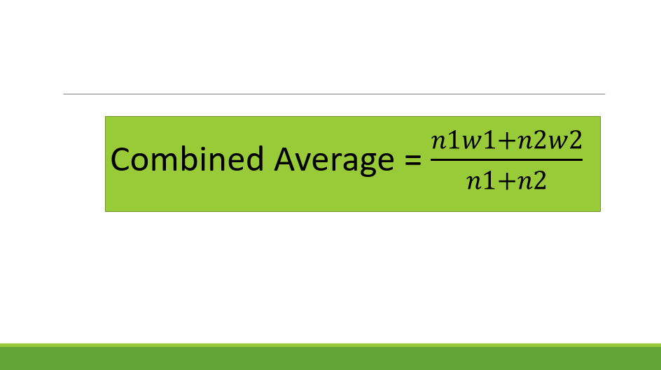

Slide 19
Question : There are 36 students in a class A whose average weight is 30kg and 24 students in class B whose average is 40kg. What will be the average if the classes are combined?
35
34
36
32

Slide 20
Question : There are 63 students in a class A whose average weight is 32kg and 21 students in class B whose average is 44kg. What will be the average if the classes are combined??
33
35
36
38

Slide 21
Question : In a class there are 20 boys and 40 girls. The average age of boys is 18 years and that of girls is 15 years. What will be the average age of the whole class?
16.5 Years
17 years
16 years
14.2 Years

Slide 22
Question : The average of marks obtained by 120 candidates was 35. If the average of passed candidate was 39 and that of failed candidate was 15, the number of candidates who passed the examination is?
100
110
120
150

Slide 23
Question : A man goes from home to his office at speed of 40km/h and return from office to home at a speed of 60Km/h. Find the average speed during whole journey.
45 Km/h
48Km/h
50Km/h
55Km/h

Slide 24
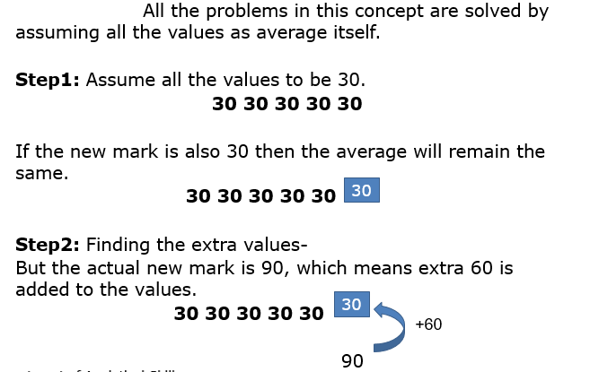
Equal Distribution of Data
Example: Average of 5 students marks is 30. If one student having 90 mark is added to the team, then what will be the new average ?

Slide 25
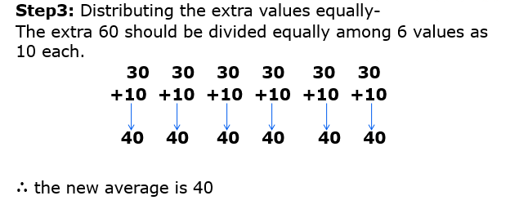

Slide 26
Question : If the average weight of 10 students in a class is 30Kg, when weight of teacher is also included new average becomes 33. Find weight of teacher.
63Kg
54Kg
66Kg
70Kg

Slide 27
Question : The average weight of a class of 24 students is 30Kg when weight of the teacher is also included the average weight is increases by 1Kg.What is the weight of teacher in kg?
60Kg
61Kg
37Kg
55Kg

Slide 28
Question : The average weight of 8 person increases by 2.5 kg when a new person comes in place of one of them weighing 65 kg. What might be the weight of the new person?
70Kg
80Kg
75Kg
85Kg

Slide 29
Question : A teacher while calculating the average marks of 30 students of an examination, by mistake enter a student’s marks as 68, instead of 86 and obtained the average as 58. Find the actual average.
59
60
58.6
60.5

Slide 30
Question : A Student’s marks were wrongly entered as 83 instead of 63. Due to that the average marks of the class got increased by 2. The number of students in class is?
10
12
15
18

Slide 31
Question : The average age of a committee of 12 members is 48 Years. A member of age 62 retired and in place a new person aged 26 joined the committee. Find the new average of the committee.
44
45
46
47

Slide 32
Question : Average of 5 numbers is 27, if one number is excluded the new average becomes 25. Find the excluded number.
35
30
38
25

Slide 33
Question : The average of a family is 24 years which is consisting of 5 members, out of which the youngest being 6 years old. What would be the average age of family just before his birth?
20
22
22.5
23.5

Slide 34
Question : The average age of 10 members in a committee is increased by 3 years when two men whose ages are 25 years and 35 years are replaced by two new men. Find the average age of two new men.
40
45
48
52

Slide 35
Question : Average of 7 values is 20. If average of first 4 is 15 and that of last 4 is 25. Find the 4th number.
20
25
30
40

Slide 36
Question : The average marks of some students is 40 and 10 of them get 60 marks instead of 90 marks by mistake. After correction, the new average becomes 50. Find the number of students.
20
30
25
35

Slide 37
Question : In a hostel there are 30 students and if the number of students increased by 5 then the expense is increased by 40 per day. But the average expenditure diminishes by 3. Find the original expenditure.
810
870
910
950

Slide 38
Question : A batsman has a certain average of runs for 16 innings, In the 17th inning, he makes a score of 85 runs there by increasing the average by 3 What is the average of 17 innings?
38
37
36
34

Slide 39
Question: If A batsman score 36 runs in his 18th innings so that his average is reduced by 3 run. Find the average of batsman in 18th inning.
(a) 90
(b) 85
(c) 87
(d) None

Slide 40
Question: A baller whose balling average is 12.4 runs/wicket. He played his next match and takes 5 wickets for 26 runs; therefore, his average is reduced by 0.4. Find the total number of wickets taken by the baller.
(a) 80
(b) 85
(c) 90
(d) 75

Slide 41
Question: The average temperature in Delhi for the first four days of the month was reported as 58°C. It reported as 60°C for 2nd, 3rd, 4th and 5th days. The ratio of the temperatures of 1st and 5th day was 7 : 8. Find the temperature on the first day.
(a) 42
(b) 46
(c) 63
(d) 56

Slide 42
Question: The average temperature of Monday, Tuesday and Wednesday is 34°C. The average temperature of Tuesday, Wednesday and Thursday is 32°C. If the temperature of Thursday is 28°C, then find the temperature of Monday.
(a) 34
(b) 36
(c) 40
(d) 42

Slide 43
Question: 6 friends went to a hotel for taking their lunch. 5 of them spent Rs.32 each while the 6th person spent 80 more than the average expenditure of all the 6 person. Find the total money spend on lunch.
(a) 280
(b) 178
(c) 285
(d) 288

Slide 44
Question: 7 friends went to a hotel for taking their lunch. 6 of them spent Rs.60 each while the 7th person spent 240 more than the average expenditure of all the 7 person. Find the total money spend on lunch.
(a) 280
(b) 700
(c) 750
(d) 650

Slide 45


